Slide 1

JC2001 Introduction to Software Engineering
Lecture 5: Requirements engineering
Dr Xiao Li xiao.li@abdn.ac.uk (BSc Artificial Intelligence)
Dr Huang Yongchao yongchao.huang@abdn.ac.uk (BSc Business Management and Information Systems)
Dr Edward Chuah thuan.chuah@abdn.ac.uk (BSc Computing Science)

Slide 2
Learning objectives
Understand the concepts of user and system requirements.
Understand the differences between functional and non-functional requirements.
Understand the main requirements engineering activities of elicitation, analysis, and validation, and the relationship between these activities.
Understand why requirements engineering is necessary.
Reference: Ian Sommerville, Software Engineering – Chapter 4, 10th edition, Pearson, 2015.

Slide 3
Outline of lecture
Introduce user and system requirements.
Describe functional and non-functional requirements.
Describe the requirements engineering process:
Requirements elicitation.
Requirements specification.
Requirements validation.
Requirements change.

Slide 4
Definition of requirements engineering
The requirements for a system are the descriptions of the services that a system should provide and the constraints on its operation.
These requirements reflect the needs of customers for a system that serves a certain purpose such as controlling a device, placing an order, or finding information.
The process of finding out, analysing, documenting and checking these services and constraints is called requirements engineering (RE).

Slide 5
User requirements
User requirements is defined as high-level statements that are written in a natural language, plus diagrams, of what services the system is expected to provide to system users and the constraints under which it must operate.
The user requirements may vary from broad statements of the system features required to detailed, precise descriptions of the system functionality.
Example of a user requirement
The Mentcare system shall generate monthly management reports showing the cost of drugs prescribed by each clinic during that month.

Slide 6
System requirements
System requirements are more detailed descriptions of the software system’s functions, services, and operational constraints.
The system requirements document (sometimes called a functional specification) should define exactly what is to be implemented. It may be part of a contract between the system buyer and the software developers.
Example of a system requirement
On the last working day of each month, a summary of the drugs prescribed, their cost and the prescribing clinics shall be generated.
The system shall generate the report for printing after 17.30 on the last working day of the month.

Slide 7
Mock quiz
What are the differences between a user requirement and a system requirement?
A user requirement provides detailed description of what a system should do. A system requirement gives more details on the implementation.
A user requirement is a high-level statement of what services the system is expected to provide. A system requirement is a more detailed description of services provided by a system and specifies exactly what is to be implemented.
A user requirement describes a system function. A system requirement describes the function’s implementation details.
Notes:
Answer is B.

Slide 8
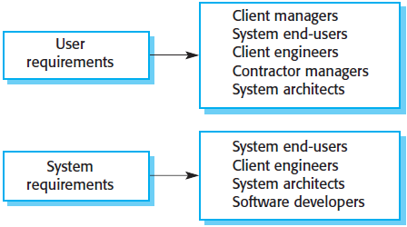
User and system requirements
The user and system requirements should be written at different levels of detail because different types of readers use them in different ways.
Notes:
For example, the readers of the user requirements are not usually concerned with how the system will be implemented and may be managers who are not interested in the detailed facilities of the system. On the other hand, the readers of the system requirements need to know more precisely what the system will do because they are concerned with how it will support the business processes or because they are involved in the system implementation.

Slide 9
System stakeholders
The system stakeholders include anyone who is affected by the system in some way and so anyone who has a legitimate interest in it.
Stakeholders range from end-users of a system through managers to external stakeholders such as regulators.
For example, the stakeholders of the Mentcare system include:
Patients. Their information is recorded in the system.
Doctors. They are responsible for assessing and treating patients.
Nurses. They coordinate the consultations with doctors and administer some treatments.
IT staff. They are responsible for installing and maintaining the system.
Medical ethics manager. They ensure that the system meets current ethical guidelines for patient care.

Slide 10
Functional requirements
These are statements of services the system should provide, how the system should react to particular inputs, and how the system should behave in particular situations.
In some cases, the functional requirements may also explicitly state what the system should do.
When expressed as user requirements, functional requirements should be written in natural language so that system users and managers can understand them.

Slide 11
Functional requirements: Mentcare system
Examples of functional requirements for the Mentcare system, used to maintain information about patients receiving treatment for mental health problems.
Function 1: A user shall be able to search the appointments lists for all clinics.
Function 2: The system shall generate each day, for each clinic, a list of patients who are expected to attend appointments that day.
Function 3: Each staff member using the system shall be uniquely identified by their eight-digit employee number.
The above user requirements define specific functionality that should be included in the system. Contrast functions 1 and 3, functional requirements can be written at different levels of detail.

Slide 12
Functional requirements: ATM machine
The mandatory actions an ATM machine should perform upon user request:
Function 1: Input the selection to withdraw funds, the ATM should dispense the selected amount.
Function 2: Input the selection to receive an account balance, the ATM should display the available amount.
Function 3: Indicates that all transactions have ended, the ATM should return the card and return to its idle state.

Slide 13
Functional requirements: ATM machine
The above-mentioned requirements are not unconditional. The ATM can only respond accordingly under the appropriate conditions:
Condition 1: The ATM should verify the card and PIN data entered into the ATM.
Condition 2: The ATM should display the operations performed by the withdrawal, balance enquiry, deposit and transfer screens only when the card and PIN data is verified by the bank.
Condition 3: The ATM should dispense the selected amount only when there is sufficient balance in the account.

Slide 14
Non-functional requirements
Non-functional requirements usually specify constrains on the characteristics of the system as a whole. They may relate to emergent system properties such as reliability, response time, and memory use.
Non-functional requirements are often more critical than individual functional requirements.
The reason is failing to meet a non-functional requirement can mean that the whole system is unusable.
For example, if the ATM machine does not meet the security requirements, it will not be certified as secure for operation.

Slide 15
Mock quiz
Why are non-functional requirements more critical than functional requirements?
Failing to meet a non-functional requirement means that the whole system becomes unusable.
Non-functional requirements help in securing a system from failures.
Non-functional requirements are better than functional requirements.
Non-functional requirements specify constrains on system performance.
Notes:
Answer is A.

Slide 16
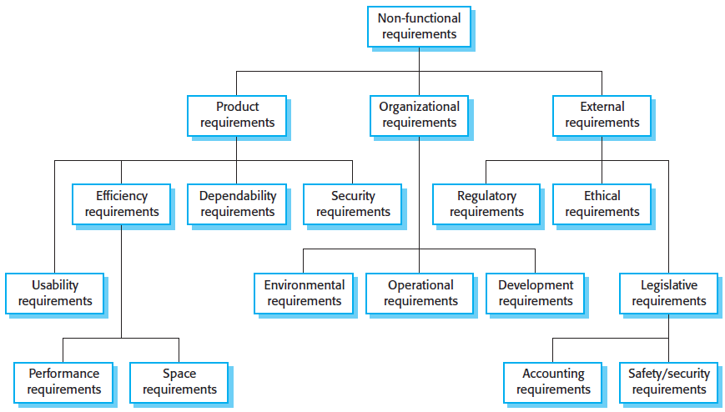
Types of non-functional requirements

Slide 17
Product requirements
These requirements specify or constrain the runtime behaviour of the system. Examples include:
Performance requirements for how fast the system must execute and how much memory it requires.
Reliability requirements that set out the acceptable failure rate.
Security requirements.
Usability requirements.

Slide 18
Organisational requirements
These requirements are broad system requirements derived from policies and procedures in the customer’s and developer’s organisations. Examples include:
Operational process requirements that define how the system will be used.
Development process requirements that specify the programming language.
The development environment or process standards to be used.
The environmental requirements that specify the operating environment of the system.

Slide 19
External requirements
This broad heading covers all requirements that are derived from factors external to the system and its development process. These may include:
Regulatory requirements that set out what must be done for the system to be approved for use by a regulator.
Legislative requirements that must be followed to ensure that the system operates within the law.
Ethical requirements that ensure that the system will be acceptable to its users and the general public.

Slide 20
Non-functional requirements: Mentcare
Product requirement:
The Mentcare system shall be available to all clinics during normal working hours (Monday to Friday, 08.30 to 17.30). Downtime within normal working hours shall not exceed 5 seconds in any one day.
Organisational requirement:
Users of the Mentcare system shall identify themselves using their health authority identity card.
External requirement:
The system shall implement patient privacy provisions as set out in the General Data Protection Regulation (GDPR).

Slide 21
Non-functional requirements: ATM
Product requirement:
The ATM shall be available 24 hours per day. Downtime shall not exceed 2 hours per week.
The cash dispense can be opened and refilled with cash.
External requirement:
The ATM will service one customer at a time.
The PIN number must be entered correctly within three attempts.

Slide 22
Mock quiz
You are the company’s lead developer responsible for managing a suite a programming languages. A new software project requires you to use a new programming language. However, your team is not familiar with the new programming language, so you need to consider the pros and cons in integrating a new programming language into your software development framework. What are the factors involved in reaching a decision? Discuss your answer.
Notes:
You will need to consider the following factors: (a) employee training because it takes time to train your team in becoming proficient in using the new programming language, (b) the amount of effort in integrating the new programming language into your software development framework, (c) deadline for delivering the software.

Slide 23
Requirements engineering processes
Requirements engineering involves three key activities:
Requirements elicitation, which involves discovering requirements by interacting with stakeholders.
Requirements specification, which involves converting these requirements into a standard form.
Requirements validation, which involves checking that the requirements actually define the system that the customer wants.
Requirements engineering is an iterative process in which the above-mentioned activities are interleaved.

Slide 24
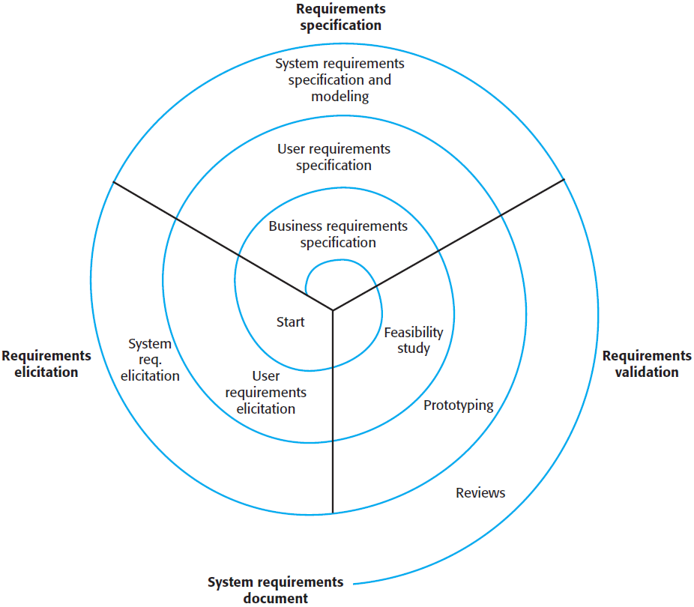
Requirements engineering processes
Early in the process, most effort will be spent on understanding high-level business and non-functional requirements, and the user requirements for the system.
Later in the process, in the outer rings of the spiral, more effort will be devoted to eliciting and understanding the non-functional requirements, and more detailed system requirements.
Notes:
Spiral view of the requirements engineering process.

Slide 25
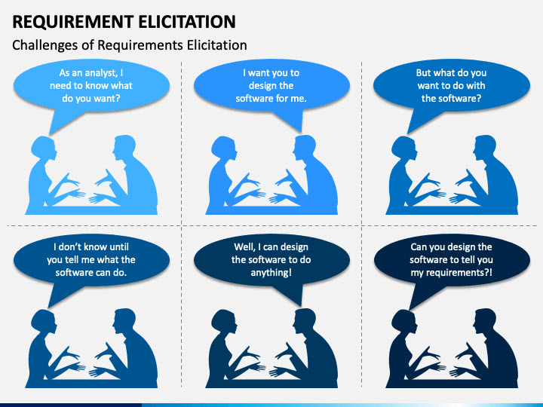
Challenges in eliciting requirements

Slide 26
Requirements elicitation
The aims of the requirements elicitation process are to understand the work that stakeholders do and how they might use a new system to help support their work. Eliciting and understanding requirements from system stakeholders is a difficult process for several reasons:
Stakeholders often don’t know what they want from a computer system except in the most general terms. They may find it difficult to articulate what they want the system to do. They may make unrealistic demands because they don’t know what is and what isn’t feasible.
Different stakeholders, with diverse requirements, may express their requirements in different ways. Requirements engineers have to discover all potential sources of requirements and discover commonalities and conflicts.

Slide 27
Requirements elicitation
Eliciting and understanding requirements from system stakeholders is a difficult process for several reasons (cont’d):
Political factors may influence the requirements of a system. Managers may demand specific system requirements because these will allow them to increase their influence in the organisation.
The economic and business environment in which the analysis takes place is dynamic. It inevitably changes during the analysis process. New requirements may emerge. The importance of particular requirements may change.

Slide 28
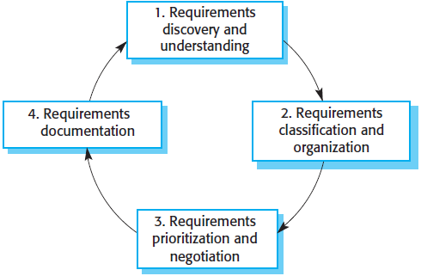
Process model for elicitation and analysis
This is the process of interacting with stakeholders of the system to discover their requirements.
The requirements are documented and input into the next round of the spiral.
This activity takes the unstructured collection of requirements and organises them into coherent clusters.
This activity is concerned with prioritising requirements and finding and resolving requirements conflicts.

Slide 29
Requirements elicitation techniques
There are two fundamental approaches to requirements elicitation:
Interviewing, where you talk to people about what they do.
Observation or ethnography, where you watch people doing their job to see what artifacts they use, how they use them, and so on.
Formal or informal interviews with system stakeholders are part of most requirements engineering processes. In these interviews, the requirements engineers put questions to stakeholders about the system that they currently use, and the system to be developed.

Slide 30
Requirements elicitation techniques: Interviews
Interviews may be of two types:
Closed interviews, where the stakeholder answers a predefined set of questions.
Open interviews, in which there is no predefined agenda. The requirements engineering team explores a range of issues with system stakeholders and hence develops a better understanding of their needs.
In practice, interviews with stakeholders are a mixture of both of these. During an interview, you usually have to ask some questions to get started and to keep the interview focused on the system to be developed.

Slide 31
Requirements elicitation techniques: Interviews
Interviews are good for getting an overall understanding of what stakeholders do, because people like talking about their work, and so they are usually happy to get involved in interviews. However, eliciting domain knowledge through interviews can be difficult, for two reasons:
All application specialists like to use jargon specific to their area of work. They normally use words in a precise and subtle way that requirements engineers may misunderstand.
Some domain knowledge is so familiar to stakeholders that they find it difficult to explain or they think it is so fundamental that it isn’t worth mentioning.
For example, a librarian knows that all acquisitions must be catalogued before they are added to the library, but this may not be obvious to the interviewer, so it isn’t taken into account in the requirements.

Slide 32
Requirements elicitation techniques: Interviews
To be an effective requirements interviewer, bear in mind the following:
Be open minded, avoid preconceived ideas about the requirements, and be willing to listen to stakeholders.
Use springboard questions or a requirements proposal to prompt the interviewee to get discussions going, or by working together on a prototype system. People find it easier to talk in a defined context, rather than in general terms.
Interviewing on its own is liable to miss essential information. So, it should be used in conjunction with other requirements elicitation techniques.

Slide 33
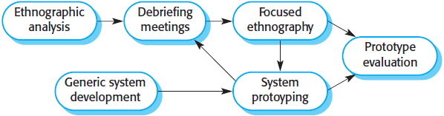
Requirements elicitation techniques: Ethnography
Ethnography is an observational technique that can be used to understand operational processes and help derive requirements for software to support these processes. Ethnography is particularly effective for discovering two types of requirements:
Requirements derived from the way in which people actually work, rather than the way in which business process definitions say they ought to work.
Requirements derived from cooperation and awareness of other people’s activities.

Slide 34
Requirements elicitation techniques: Stories
Stories and scenarios are ways of capturing how users of a system handle particular situations or imagine things that they might do in a new way of working.
Stories and scenarios are essentially the same thing. They are a description of how the system can be used for some particular task. They describe what people do, what information they use and produce, and what systems they may use in this process. The difference is in the way stories and scenarios are structured and presented.
Stories are usually written as narrative text and present a high-level description of system use.
Scenarios are usually written with specific information collected such as inputs and outputs.

Slide 35
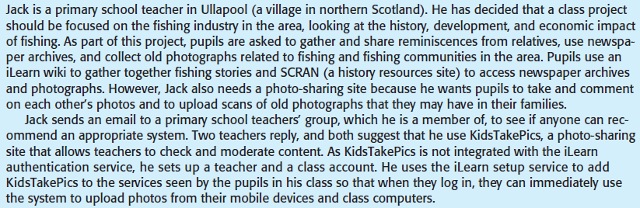
Requirements elicitation techniques: Story
A user story for the iLearn system

Slide 36
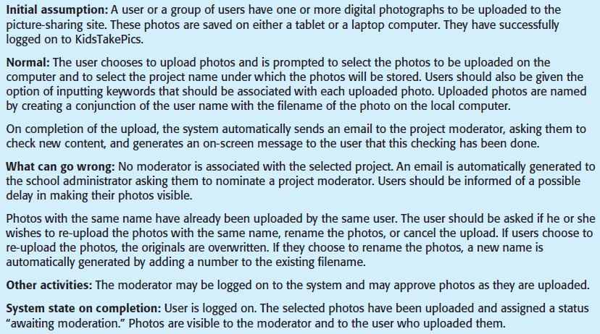
Requirements elicitation techniques: Scenario
Scenario for uploading photos to the iLearn system

Slide 37
Requirements specification
Requirements specification is the process of writing down the user and system requirements in a requirements document. Ideally, the user and system requirements should be clear, unambiguous, easy to understand, etc., but in practice this is almost impossible to achieve. Stakeholders interpret the requirements in different ways, and there are often inherent conflicts and inconsistencies in the requirements.
User requirements are almost always written in natural language supplemented by appropriate diagrams and tables in the requirements document.
System requirements may also be written in natural language, but other notations based on mathematical notations, etc. can also be used.

Slide 38
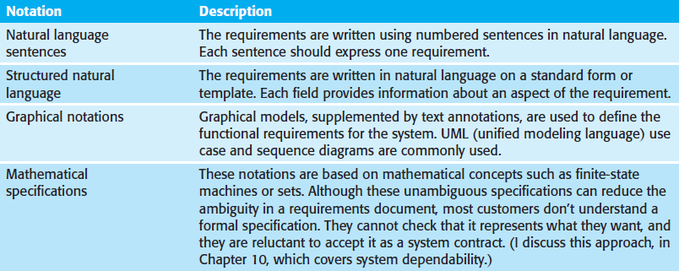
Requirements specification

Slide 39
Natural language specification
Natural language has been used to write requirements for software since the 1950s. It is expressive, intuitive, and universal, but it is also potentially vague and ambiguous, and its interpretation depends on the background of the reader. To minimise misunderstanding when writing natural language requirements, the following guidelines can be used:
Invent a standard format and ensure all requirement definitions adhere to that format.
Use language consistently to distinguish between mandatory and desirable requirements. Mandatory requirements are usually written using ``shall’’. Desirable requirements are not essential and are usually written using ``should’’.
Use text highlighting (e.g., bold, italic, colour) to pick out key parts of the requirement.

Slide 40
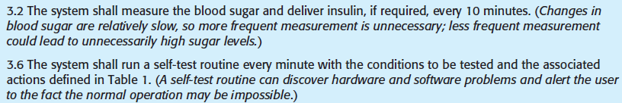
Natural language specification
To minimise misunderstanding when writing natural language requirements, the following guidelines can be used (cont’d):
Wherever possible, avoid the use of jargon, abbreviations, and acronyms.
Wherever possible, try to associate a rationale with each user requirement. The rationale explains why the requirement has been included and who proposed the requirement, so that you know whom to consult if the requirement has to be changed.

Slide 41
Structured specification
Structured natural language is a way of writing system requirements where requirements are written in a standard way rather than as free-form text. This approach maintains most of the expressiveness and understandability of natural language but ensures that some uniformity is imposed on the specification. Structured language notations use templates to specify system requirements, and it may use programming language constructs such as if-then-else and for-1-to-n to show alternatives and iterations.
When a standard format is used for specifying functional requirements, the following information should be included:
A description of the function or entity being specified.
A description of its inputs and the origin of these inputs.

Slide 42
Structured specification
When a standard format is used for specifying functional requirements, the following information should be included (cont’d):
A description of its output and the destination of these outputs.
Information about the information needed for the computation or other entities in the system that are required.
A description of the action to be taken.
If a functional approach is used, a precondition setting out what must be true before the function is called, and a postcondition specifying what is true after the function is called.
A description of the side effects (if any) of the operation.

Slide 43
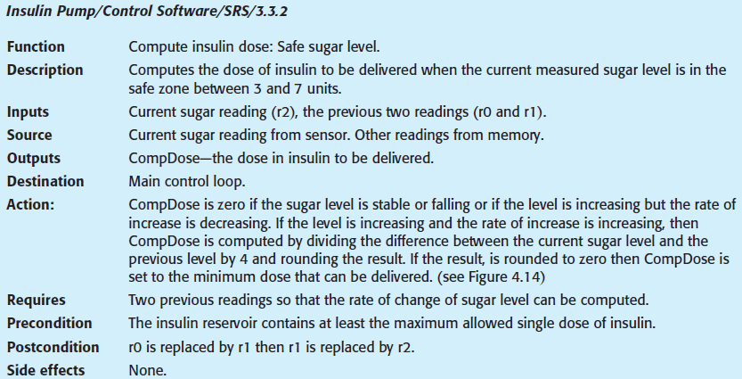


Structured specification

Slide 44
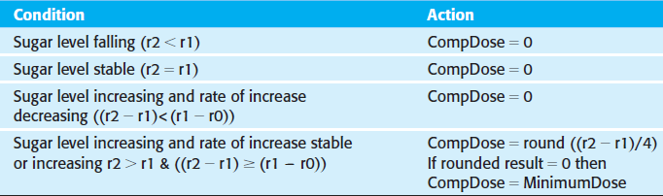
Structured specification
The structured specifications removes some of the problems of natural language specification. Variability in the specification is reduced, and requirements are organised more effectively. However, it is still difficult to write requirements in a clear and unambiguous way, particularly when complex computations are to be specified. To address this problem, extra information such as tables or graphical models of the system can be added.

Slide 45
Use cases
Use cases are a way of describing interactions between users and a system using a graphical model and structured text. Use cases were first introduced in the Objectory method (Jacobsen et. al., 1993) and have now become a fundamental feature of the Unified Modeling Language (UML).
In their simplest form, a use case identifies the actors involved in an interaction and names the type of interaction.
Additional information that describes the interaction with the system can be added; it may be a textual description or one or more graphical models such as UML sequence diagrams or state charts.

Slide 46
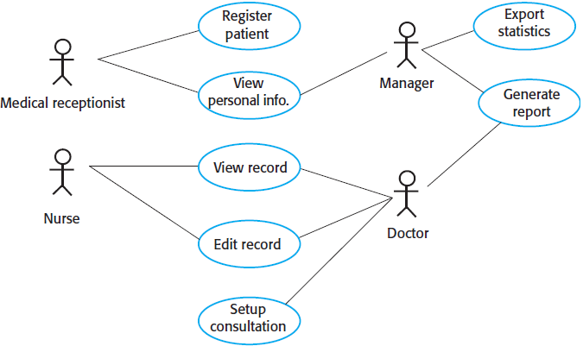
Use cases: Mentcare system

Slide 47
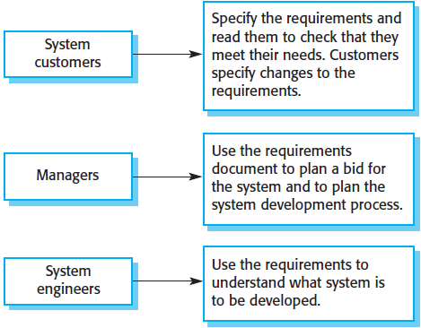
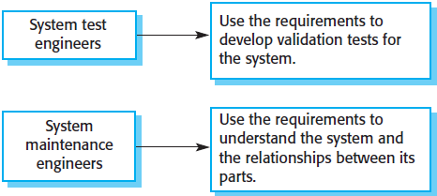
Users of the software requirements document

Slide 48
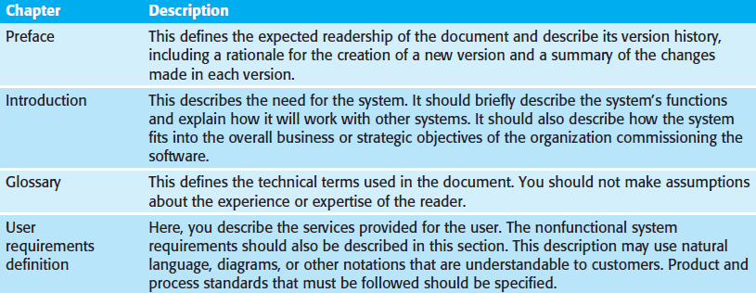
Structure of a requirements document
Based on an IEEE standard for requirements document (IEEE 1998). This standard is a generic one that can be adapted to specific uses.

Slide 49
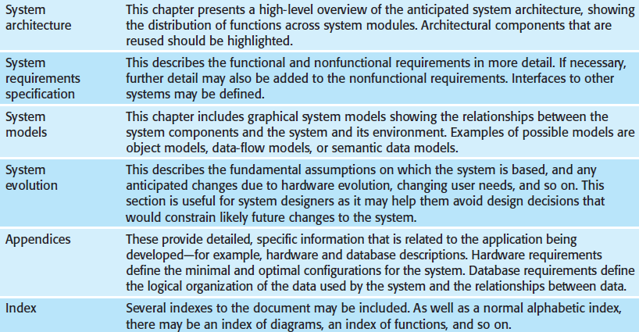
Structure of a requirements document (cont’d)

Slide 50
Requirements validation
Requirements validation is the process of checking that requirements define the system that the customer really wants. It overlaps with elicitation and analysis, as it is concerned with finding problems with the requirements.
Different types of checks should be carried out on the requirements document. These checks include:
Validity checks. These check that the requirements reflect the real needs of system users.
Consistency checks. Requirements in the document should not conflict.
Completeness checks. The requirements document should include requirements that define all functions and the constraints intended by the system user.

Slide 51
Requirements validation
Different types of checks should be carried out on the requirements document. These checks include (cont’d):
Realism checks. By using knowledge of existing technologies, the requirements should be checked to ensure that they can be implemented within the proposed budget for the system. These checks should also take account of the budget and schedule for the system development.
Verifiability. To reduce potential for dispute between customer and contractor, system requirements should always be written so that they are verifiable. This means that you should be able to write a set of tests that can demonstrate that the delivered system meets each specified requirement.

Slide 52
Requirements validation
A number of requirements validation techniques can be used individually or in conjunction with one another:
Requirements reviews. The requirements are analysed systematically by a team of reviewers who check for errors and inconsistencies.
Prototyping. This involves developing an executable model of a system and using this with end-users and customers to see if it meets their needs and expectations.
Test-case generation. Requirements should be testable. If the tests for the requirements are devised as part of the validation process, this often reveals requirements problems. If a test is difficult or impossible to design, this usually means that the requirements will be difficult to implement and should be reconsidered.

Slide 53
Requirements change
The requirements for large software systems are always changing. Most changes to system requirements arise because of changes to the business environment of the system:
The business and technical environment of the system always changes after installation. New hardware may be introduced and existing hardware updated. It may be necessary to interface the system with other systems.
The people who pay for a system and the users of that system are rarely the same people. New features may have to be added for user support if the system is to meet its goals.
Large system usually have a diverse stakeholder community, with stakeholders having different requirements.

Slide 54

Requirements change management
Requirements management planning is concerned with establishing how a set of evolving requirements will be managed. There are three stages to a change management process:
Problem analysis and change specification. Start with an identified requirements problem, then analyse the change proposal to check if it is valid.
This analysis is fed back to the change requestor, who may decide to give a more detailed proposal, or withdraw the request.

Slide 55
Requirements change management
There are three stages to a change management process (cont’d):
Change analysis and costing. The effect of the proposed change is assessed using traceability information and general knowledge of the system requirements.
The cost is estimated in terms of modifications to the requirements, and to the system design and implementation.
Once the analysis is completed, a decision is made as to whether or not to proceed with the change.

Slide 56
Requirements change management
There are three stages to a change management process (cont’d):
Change implementation. The requirement document and, where necessary, the system design and implementation, are modified.
The requirements document should be organised so that changes can be made to it without extensive rewriting or reorganisation.
This can be achieved by making the document as modular as possible and by minimising external references.

Slide 57
Lessons learned
We defined requirements engineering, user and system requirements and showed examples of user and system requirements.
We described functional and non-functional requirements, and discussed the differences between functional and non-functional requirements.
We described the requirements engineering process, and discussed the main activities of elicitation, specification, validation and change in the RE process.

